Slide 1
INTRODUCTION TO VERSION CONTROL GIT And GitHub

Slide 2
To be discussed…..
What is Version Control System?
TYPES OF VERSION CONTROL.
GIT background and Interest Over time Graph
What is GIT?
What is GITHUB ?
Git and GitHub are same ?
GIT Terminologies
Life Cycle.
Workflow.
Advantages of Github.
Disadvantages of Github.

Slide 3
Version Control System
Version control systems are a category of software tools that help a software team manage changes to source code over time. Version control software keeps track of every modification to the code in a special kind of database. If a mistake is made, developers can turn back the clock and compare earlier versions of the code to help fix the mistake while minimizing disruption to all team members.

Slide 4
TYPES OF VERSION CONTROL
One fundamental tool in any software project is a Version Control System . It is also very helpful to keep backed-up versions of your work just in case anything goes wrong.
Centralized VCS
Distributed VCS

Slide 5
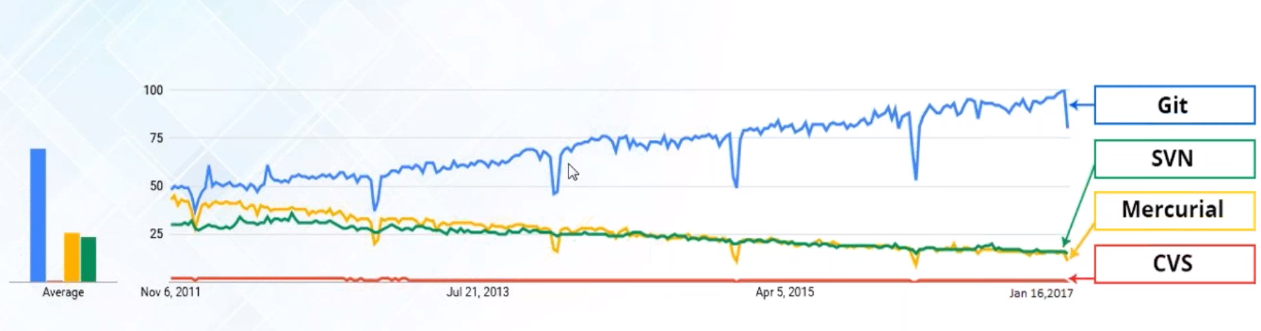
GIT background and Interest Over time Graph
Original author : Linus Torvalds.
Developer : Junio Hamano.
Written in : C, Shell, Perl, TCL, Python.
OS : LINUX, WINDOWS, MACOS.
LICENSE : GNU GPL V2 and GNU LGPL V2.1.

Slide 6
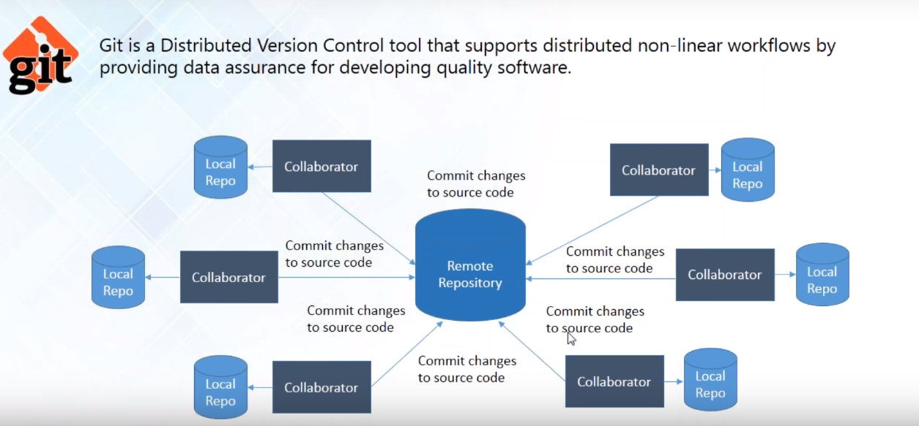
What is GIT ?

Slide 7
What is GITHUB ?
GITHUB is a web-based Centralized Repository and version control System. It is mostly used for computer code. It coordinates with all local distributed version control systems and stores their codes.

Slide 8
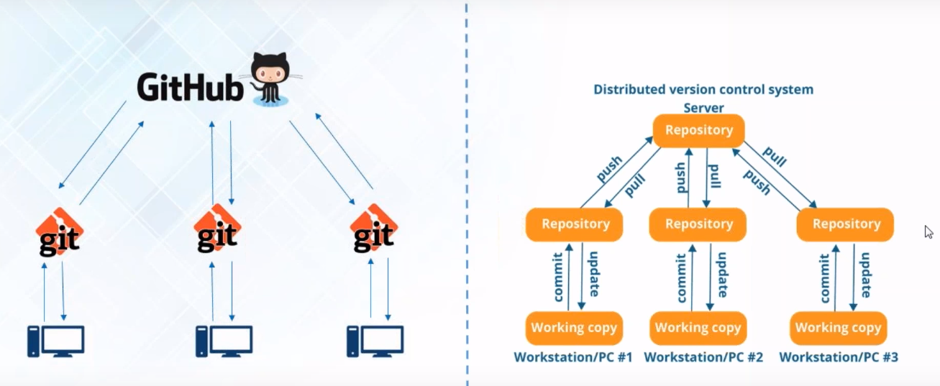
Git and GitHub are same ….?

Slide 9
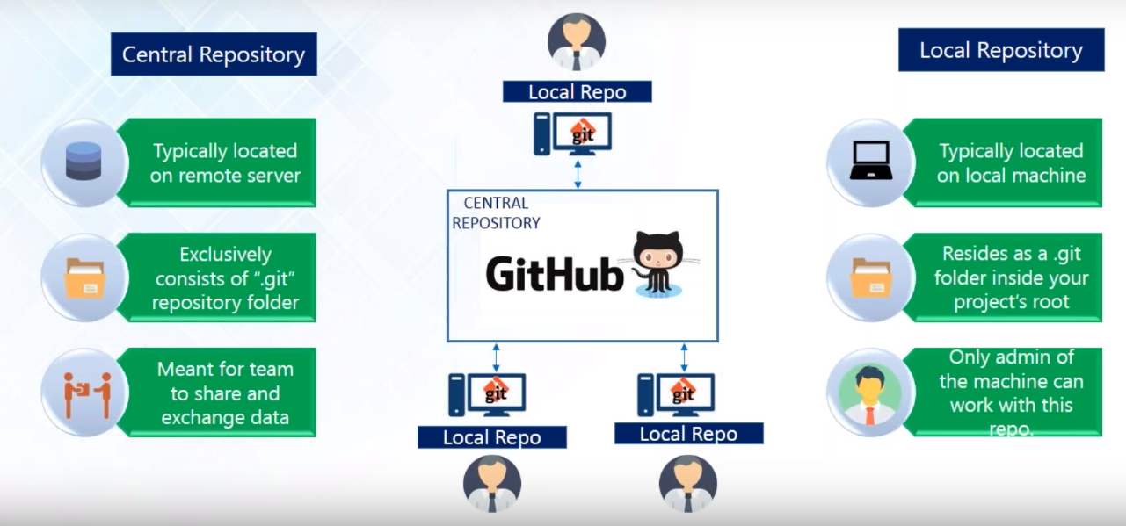
Git and GitHub

Slide 10
GIT Terminologies
Local Repository.
Working Directory and Staging Area or Index.
Blobs.
Trees.
Commits.
Branches.
Tags.
Clone.
Pull.
Push.
Head.
Revision
URL.

Slide 11
Life Cycle

Slide 12
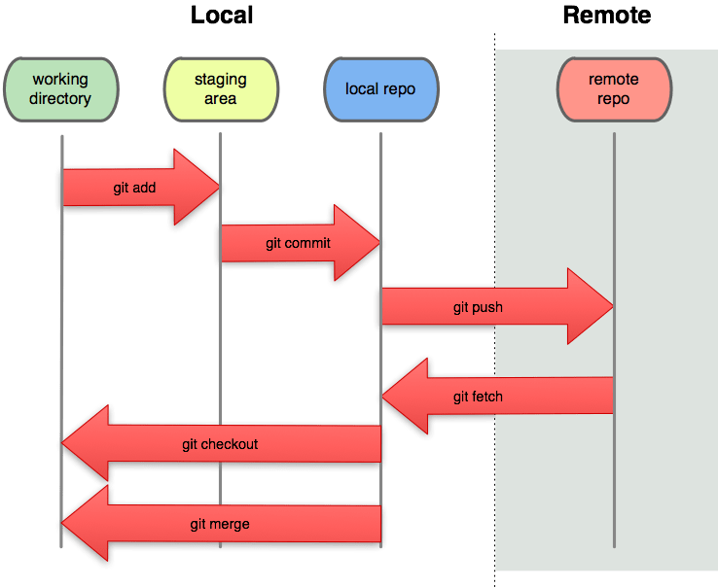
Workflow

Slide 13
Advantages of Github
Free and open source.
Fast and small.
Implicit backup.
Security.
No need of powerful hardware.
Easier branching.
Workflow is flexible.
Distributed model.
Pull requests.

Slide 14
Disadvantages of Git
Steep learning curve.
Binary files are a big no.

Slide 15
GIT Vs CLEARCASE
File modification.
Branching.
Choosing the workflow.
Locking.
Backup.

Slide 16
THANKS

